Slide 1
ChatGPT

Slide 2
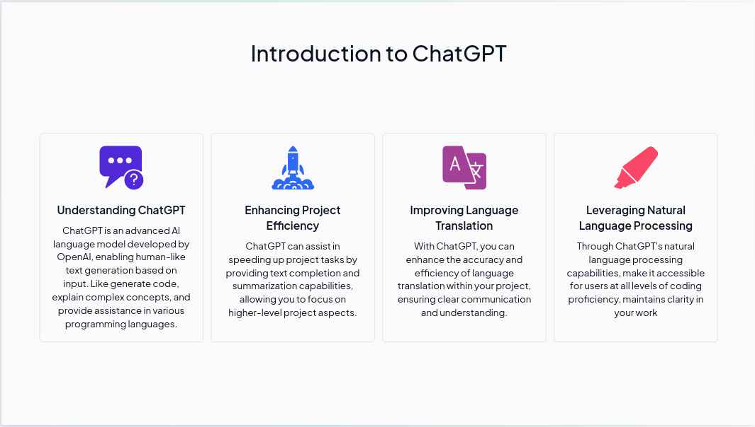

Slide 3
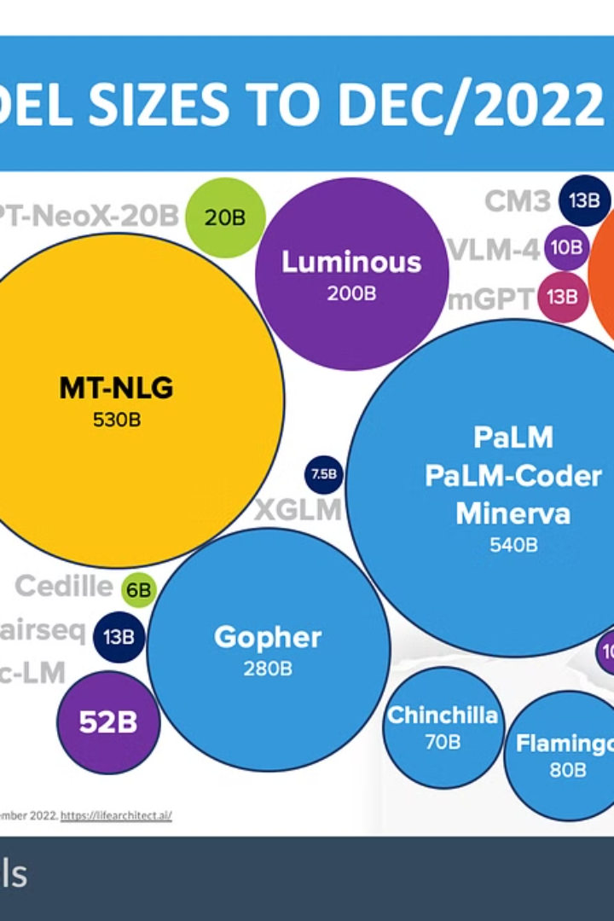
What is ChatGPT?
1
Developed by OpenAI
ChatGPT is an AI-powered conversational model designed to generate human-like text responses.
2
Advanced Natural Language Processing
It utilizes advanced natural language processing techniques to understand and respond to user queries.
3
Engaging Conversations
ChatGPT has gained popularity for its ability to simulate engaging conversations across various platforms.

Slide 4
Tailoring Responses to Your Needs
ChatGPT enables the customization of responses to meet specific requirements.
It allows users to adjust tone, style, and content to match their preferences.
Responses can be customised for different contexts and audiences.
This customisation enhances user engagement and satisfaction.

Slide 5
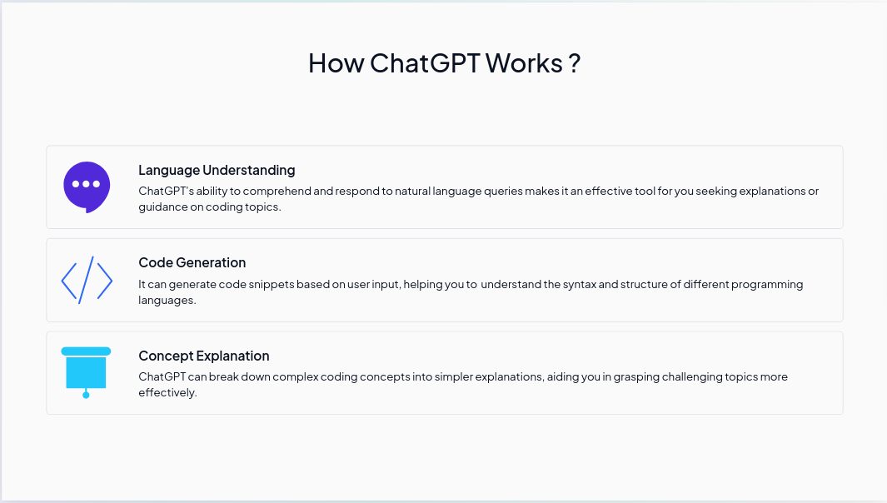

Slide 6
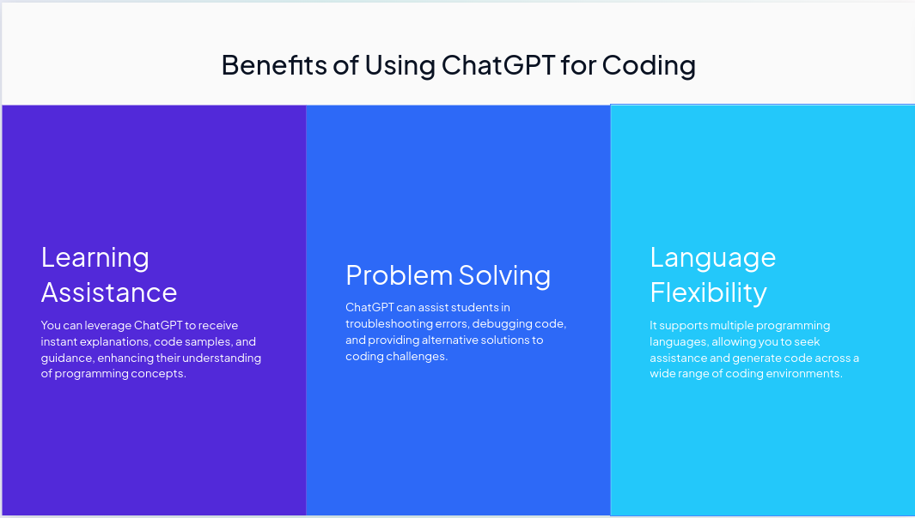

Slide 7
Six Strategies for Better Results with Prompt Engineering.

Slide 8
Introduction
Definition: Prompt engineering involves crafting specific instructions or queries to guide AI models in generating desired outputs.
Purpose: The primary goal of prompt engineering is to optimize the performance of AI models by providing them with clear, tailored instructions.
Importance: Effective prompt design is crucial for ensuring that AI models produce accurate, relevant, and contextually appropriate responses.
Overview: In this presentation, we will explore six strategies for enhancing the effectiveness of prompt engineering to optimize AI model outputs. These strategies will provide valuable insights into crafting prompts that yield superior performance and accuracy.
Key Concepts:
Specificity: Crafting prompts that are clear, concise, and tailored to the task at hand.
Context: Incorporating relevant context or constraints into prompts to guide model behavior.
Experimentation: Iteratively refining prompts based on model outputs and performance to achieve better results.

Slide 9
Clear Instructions
Write Clear Instructions: Provide specific, clear instructions defining the desired output length, complexity, and format to enhance model accuracy.
Prompt: "Write a 200-word summary of the impact of climate change on polar bear populations. Include details on habitat loss and food scarcity."

Slide 10
Reference Text
Provide Reference Text: Counteract potential fabrications by offering concrete reference materials to guide the model towards accurate answers.
Prompt: "Explain the concept of quantum entanglement using references from reputable physics journals such as 'Physical Review Letters' and 'Nature Physics'."

Slide 11
Complex Tasks
Split Complex Tasks into Simpler Subtasks: Break down tasks into manageable steps to reduce errors and improve workflow.
Prompt: "Break down the process of launching a satellite into space into individual steps, including design, construction, testing, and launch.”

Slide 12
Think
Give the Model Time to "Think": Allow the model to process and reason, encouraging a "chain of thought" approach for accurate reasoning.
Prompt: "Consider the ethical implications of artificial intelligence in healthcare. Take a moment to reflect on the potential benefits and risks before providing a response."

Slide 13
External Tools
Use External Tools: Supplement the model's capabilities with specialized tools like text retrieval systems or code execution engines for specific tasks.
Prompt: "Utilize the OpenAI Code Interpreter to generate Python code for solving a quadratic equation. Provide the code snippet for execution and verification.”

Slide 14
Test
Test Changes Systematically: Measure improvements systematically to ensure modifications lead to enhanced overall performance.
Prompt: "Compare the effectiveness of two different prompts in generating a summary of a scientific research paper. Evaluate the quality of the outputs systematically to determine the most effective prompt.”

Slide 15
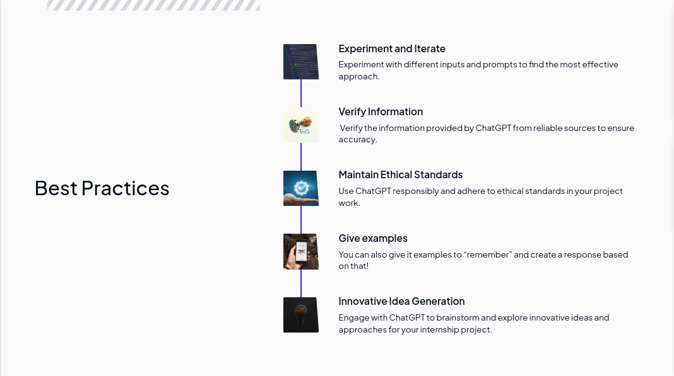

Slide 16
Key Tips for Using ChatGPT
1
Generate to-do list or step-by-step guide
2
Experiment with different prompts
Use ChatGPT to generate a to-do list or a step-by-step guide based on given documentation.
Try out various prompts to get the optimal output from ChatGPT.
3
Share chat thread links
4
Export chat logs and download
You can share chat thread links to collaborate or refer to previous conversations.
Export and download chat logs for record-keeping or further analysis.
5
Keyboard shortcuts
6
Quick learning and summarizing
Learn and utilize keyboard shortcuts to enhance your productivity while using ChatGPT.
Use ChatGPT for quick learning by summarizing articles and generating key points. You can also revise topics and even have quizzes based on subjects/concepts.
7
Create customized plans
8
Customize ChatGPT responses
Personalize your plans according to your daily tasks and schedule using ChatGPT.
Customize the responses of ChatGPT to tailor it to your specific needs and preferences.
9
Overcome word limitations
10
Specify output format
If you encounter word limitations, simply say "Go on" to allow ChatGPT to continue generating output.
You can specify the desired output format to get the information in the format you need.
11
Use long prompts or sets of prompts
Feel free to use long prompts or sets of prompts to provide context and get more accurate and relevant responses from ChatGPT.

Slide 17
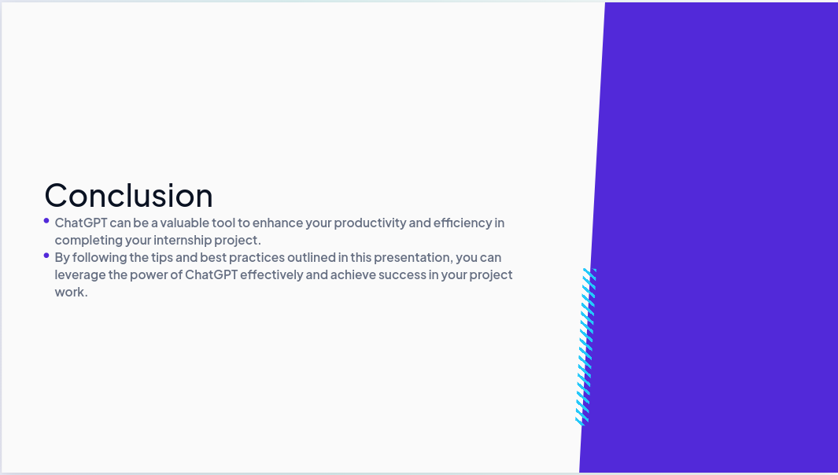

Slide 18
References:
https://platform.openai.com/docs/guides/prompt-engineering/strategy-test-changes-systematically
https://platform.openai.com/docs/guides/prompt-engineering/six-strategies-for-getting-better-results

Slide 19
Thank you

